Slide 1


NFLUENT
Smooth your .NET TDD experience!
thomas@pierrain.net - Brown Bag Lunch - December 2013

Slide 2
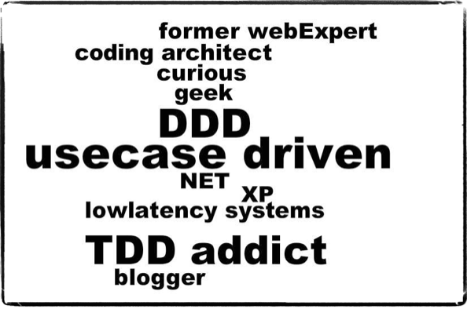
WHO AM I?

Slide 3
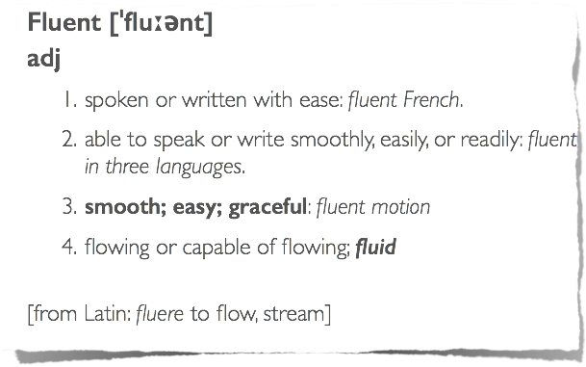
UBIQUITOUS LANGUAGE
(source: http://www.thefreedictionary.com/fluent)

Slide 4

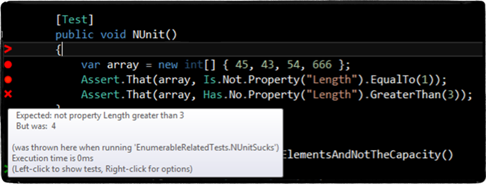
TDD WITH LEGACY TOOLS
      Is it fluent to read?
      Is it intuitive and fluent to write?
      Is it easy to troubleshoot?

Slide 5

TDD WITH LEGACY TOOLS
      Is it fluent to read?
      Is it intuitive and fluent to write?
      Is it easy to troubleshoot?

Slide 6

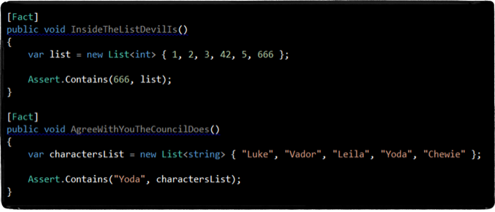

BY TEST DEVELOPMENT DRIVEN IS?

Slide 7
USE CASE DRIVEN ...
Provide a fluent writing and error-proof experience for tests
Provide a fluent reading experience for test
Provide a fluent troubleshooting experience for test

Slide 8
NFLUENT IS...
... the answer to those 3 challenges

Slide 9
THE PIT OF SUCCESS
Provide a fluent writing and error-proof experience for tests
  A unique entry point for assertions (Check.That)
  Intellisense guided writing (a.k.a. the super-duper-happy dot exp)
Provide a fluent reading experience for test
  Natural language assertions
Provide a fluent troubleshooting experience for test
  Non ambiguous error messages

Slide 10
THE PIT OF SUCCESS
  A unique entry point for assertions (Check.That)
  Intellisense guided writing (a.k.a. the super-duper-happy dot exp)
  Natural language assertions
  Non ambiguous error messages

Slide 11
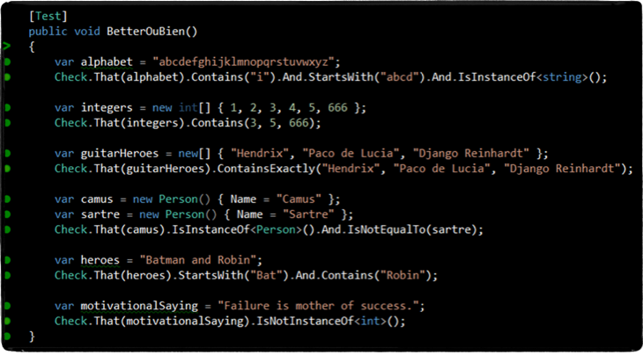
NFLUENT SAMPLES

Slide 12
DEMO

Slide 13

WRAP UP
NFluent is:
  A new OSS .NET library for fluent assertions
  Independent and compliant with all major .NET test runners
  Directly inspired by the awesome Java FEST assert library
  Available on

Slide 14
BONUS FEATURES
A fully extensible model
  To easily add your own assertions on any kind of ‘value’
  The opportunity to use your own ubiquitous language (DSL) from within your tests
Some extra candies
  Like the Properties extension method for IEnumerable

Slide 15
NFLUENT VS. OTHER
ASSERTION LIBRARIES?
(like: FluentAssertion, Sharp Tests Ex, etc.)
Their usage of lambda expression predicates hurts the fluent experience
  new[] { 1, 2, 3 }.Should().Contain(item => item > 3, "at least {0} item should be larger than 3", 1);
(Red is dead, but) Should is weak…
We aims to be more ambitious in term of fluentness. Will we succeed?

Slide 16

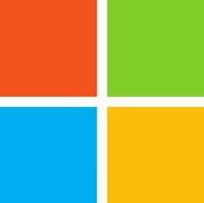


FINAL QUESTION

Slide 17


TAKE AWAY
Does your test framework dictate the way you work, or is it the other way around?
Try NFluent!
  http://www.n-fluent.net
  https://groups.google.com/forum/#!forum/nfluent-discuss
  (NFluent logo © rhwy)

Slide 18
TAKE AWAY
Does your test framework dictate the way you work, or is it the other way around?
Try NFluent!
  http://www.n-fluent.net
  https://groups.google.com/forum/#!forum/nfluent-discuss
Thank you!
  (NFluent logo © rhwy)

